Slide 1
JAVA STREAM API
By :- SAGAR KAMDI AND SHREYA POHARKAR

Slide 2
JAVA STREAM API :-
Introduced in Java 8, the Stream API is used to process collections of objects. A stream is a sequence of objects that supports various methods which can be pipelined to produce the desired result.
The features of Java stream are :–
1]A stream is not a data structure instead it takes input from the Collections, arrays or I/O channels.
2]Streams don’t change the original data structure, they only provide the result as per the pipelined methods.
3] Each intermediate operation is lazily executed and returns a stream as a result, hence various intermediate operations can be pipelined. Terminal operations mark the end of the stream and return the result.

Slide 3
Stream represents a sequence of objects from a source, which supports aggregate operations. Following are the characteristics of a Stream −
Sequence of elements − A stream provides a set of elements of specific type in a sequential manner. A stream gets/computes elements on demand. It never stores the elements.
Source − Stream takes Collections, Arrays, or I/O resources as input source.
Aggregate operations − Stream supports aggregate operations like filter, map, limit, reduce, find, match, and so on.
Pipelining − Most of the stream operations return stream itself so that their result can be pipelined. These operations are called intermediate operations and their function is to take input, process them, and return output to the target. collect() method is a terminal operation which is normally present at the end of the pipelining operation to mark the end of the stream.
Automatic iterations − Stream operations do the iterations internally over the source elements provided, in contrast to Collections where explicit iteration is required.
With Java 8, Collection interface has two methods to generate a Stream.
stream() − Returns a sequential stream considering collection as its source.
parallelStream() − Returns a parallel Stream considering collection as its source.

Slide 4
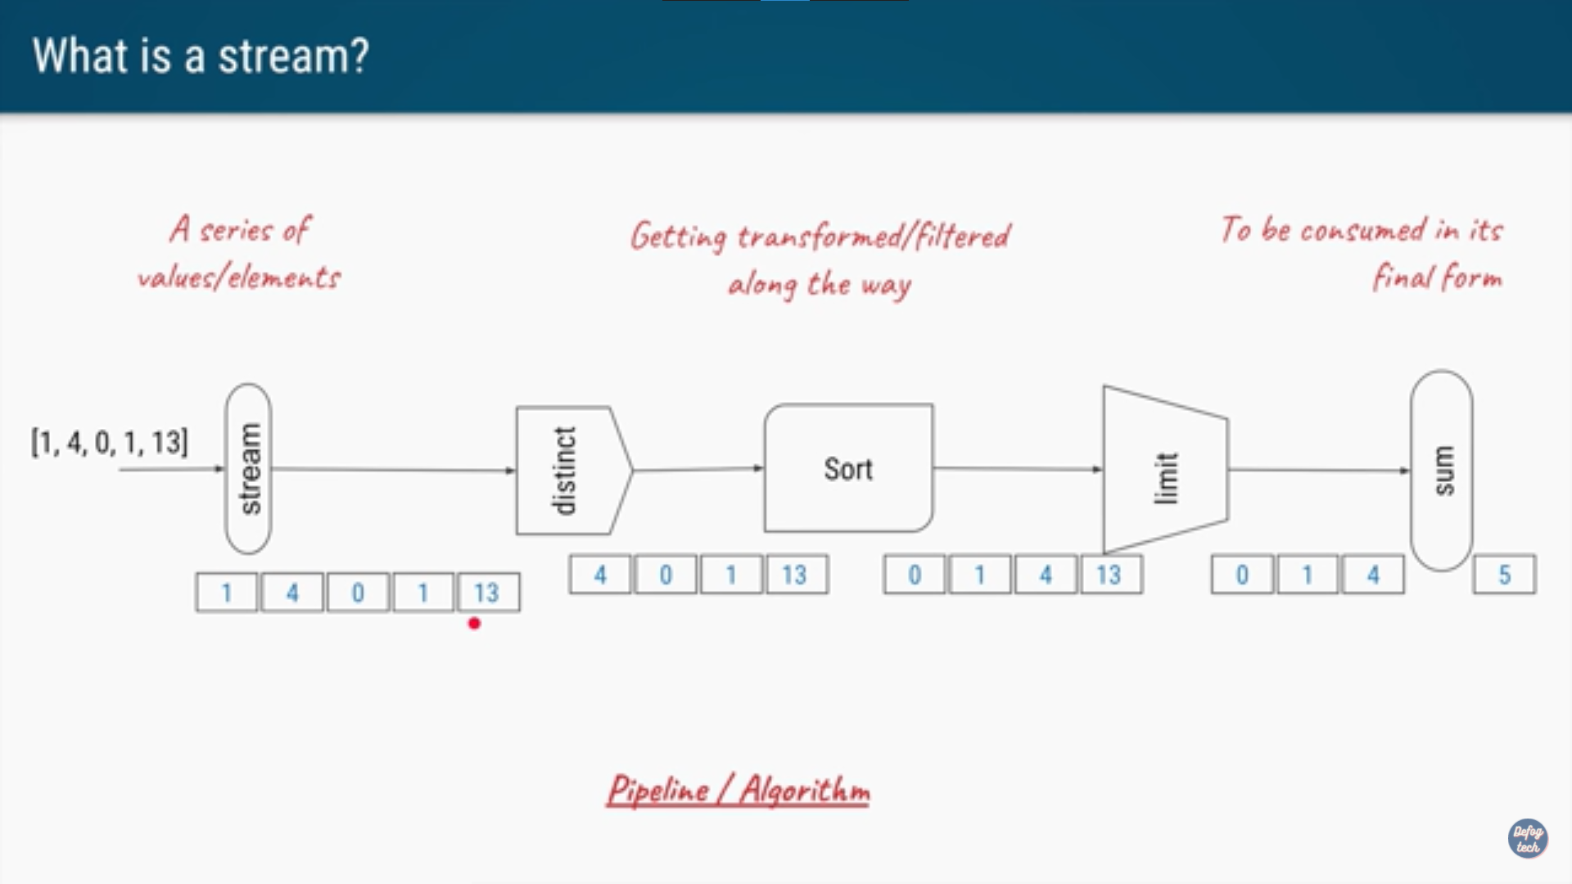
HOW DOES A STREAM WORK ?
Let us assume we have to pass an array [1,4,0,1,13]
and we have to perform following operations on it:-
1) Creation of and Using a Stream()
2)Removing duplicat values
3)Sort it in ascending order
4) Limit it to 3 values
5) Print the sum of the 3 values
THERE ARE 3 STAGES HERE:-
CREATION OF STREAM
PROCESSING
CONSUMPTION OF STREAM

Slide 5
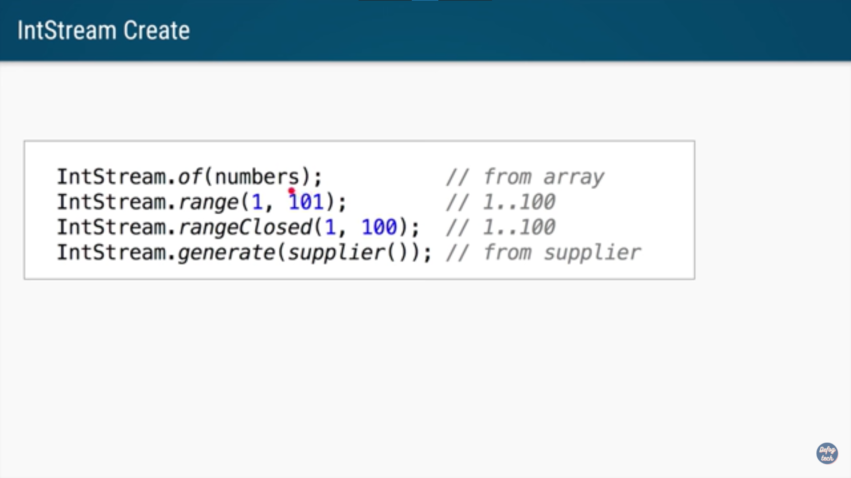
CREATION OF STREAM :-

Slide 6
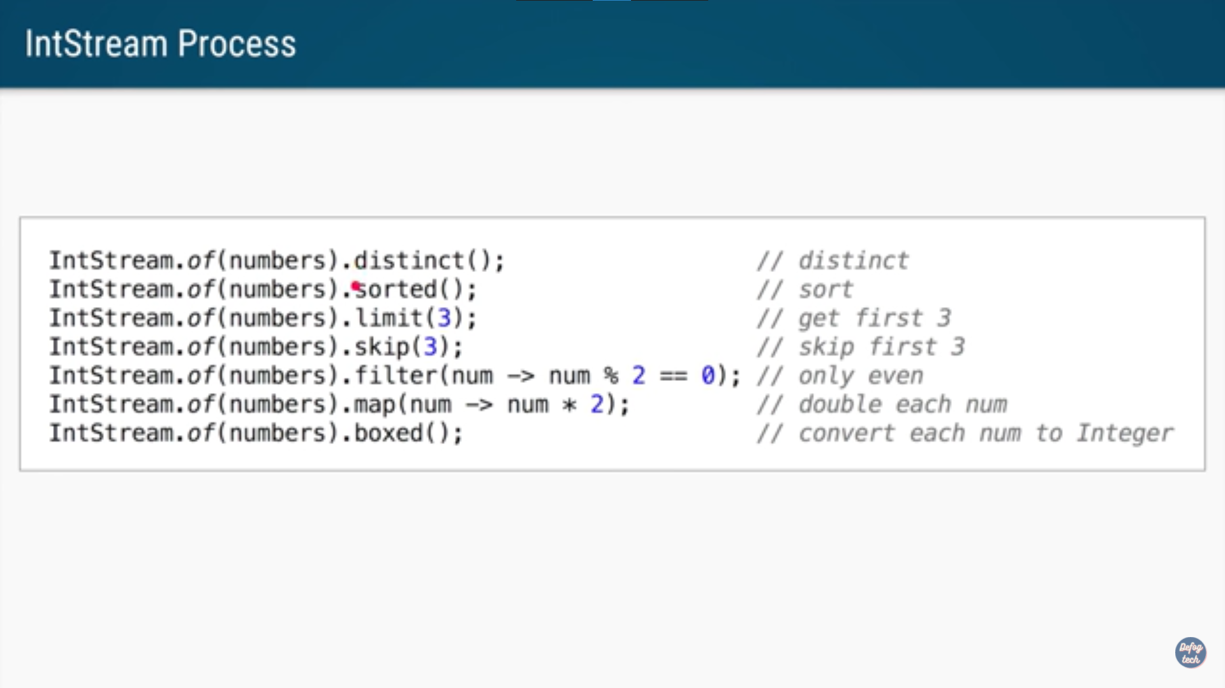
PROCESSING OF STREAM:-

Slide 7
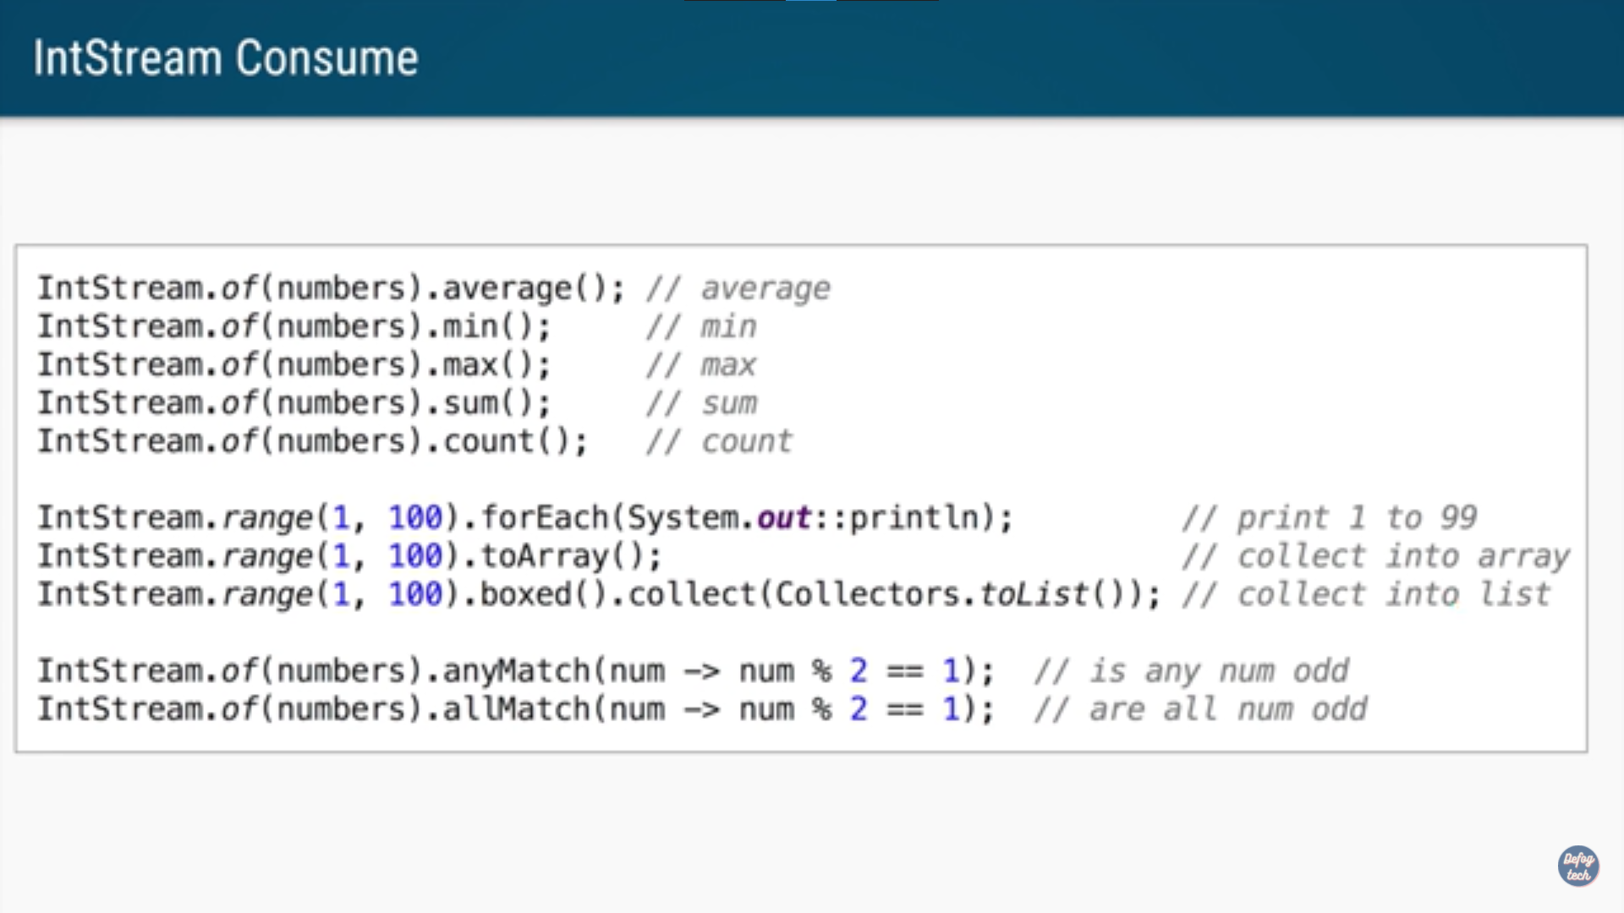
CONSUMPTION OF STREAM:-

Slide 8
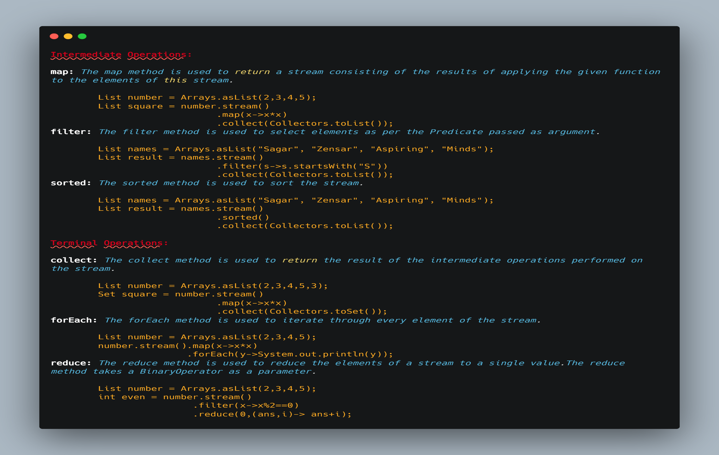

Slide 9
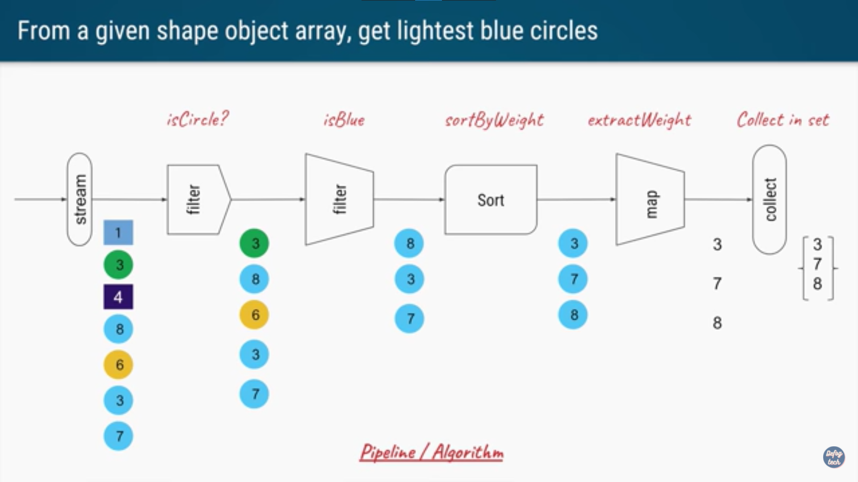
HOW STREAM DOES PROCESSING ON OBJECTS?

Slide 10
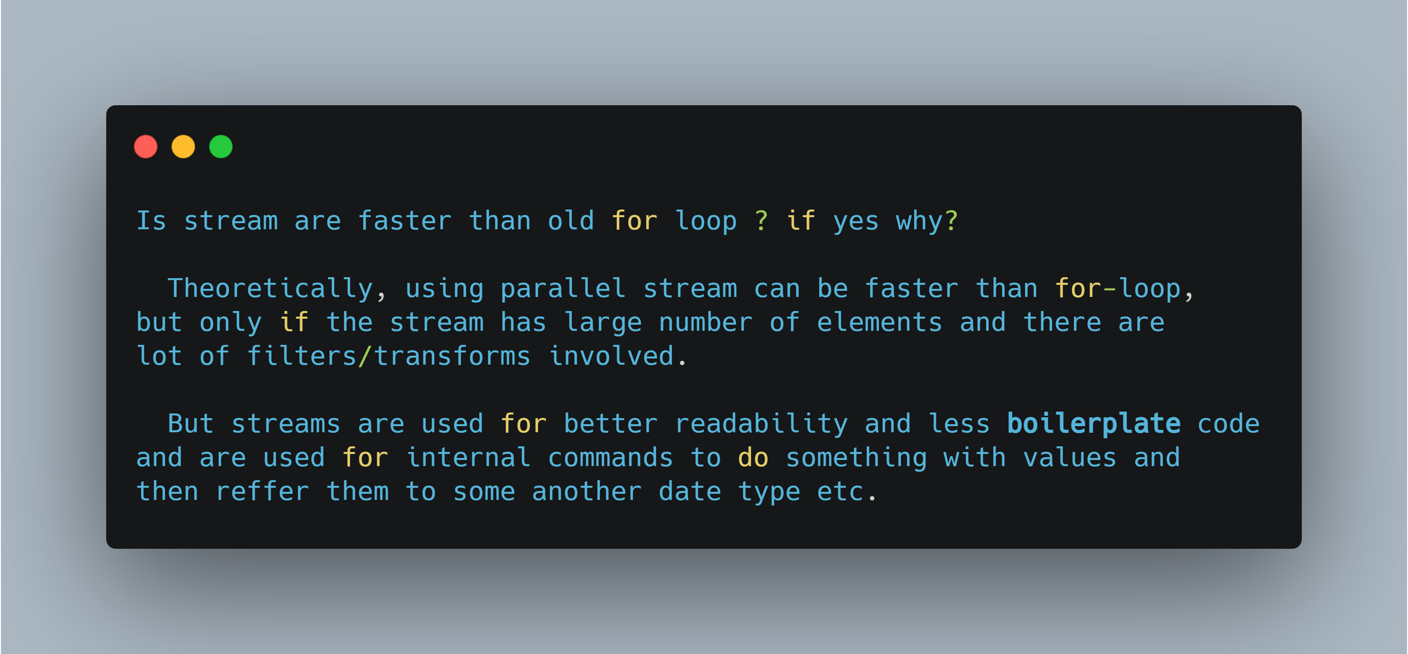

Slide 11
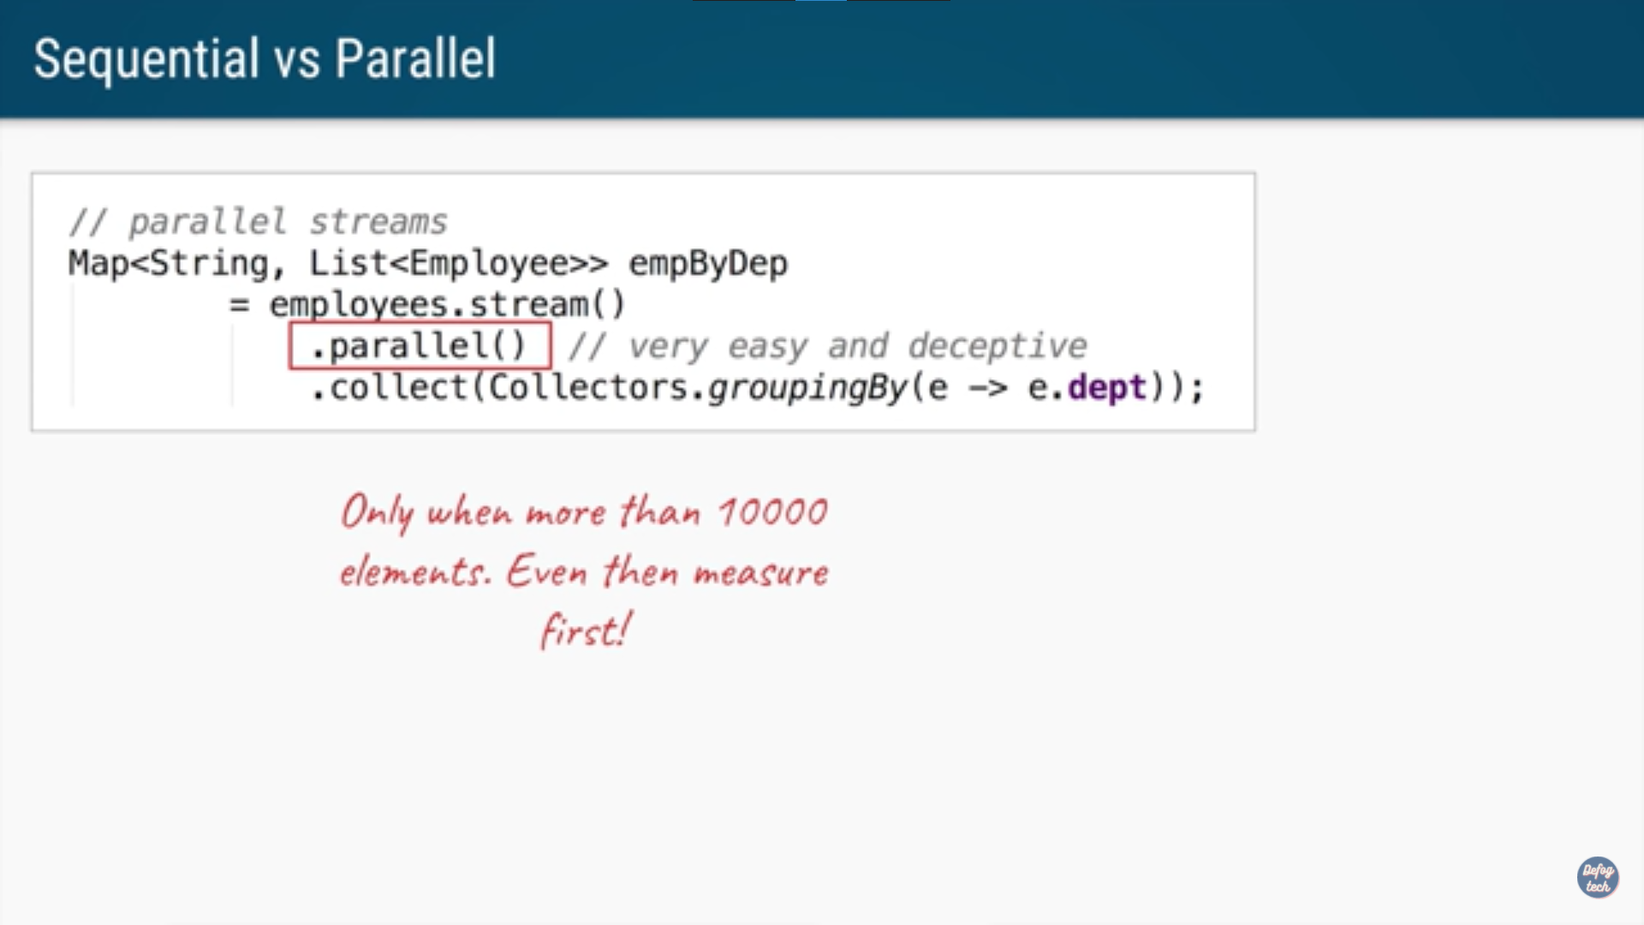
PARALLEL STREAM IN JAVA:-
Now as we know there are 2 types of string generation:-
1)Stream()
2)parrallel stream()
Basicallly parallel stream is uesd when we have process a big chunk of data . Also for ex, if we have to use all cores of our processor we use multi-threading for it. Parallel stream uses that concept only and automatically create multiple threads for us.

Slide 12
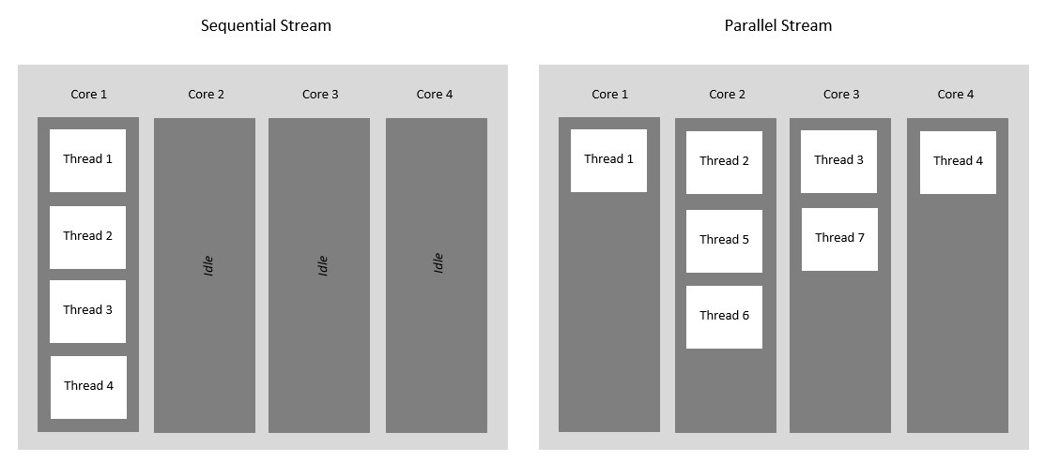
Java Parallel Streams is a feature of Java 8 and higher, meant for utilizing multiple cores of the processor. Normally any java code has one stream of processing, where it is executed sequentially. Whereas by using parallel streams, we can divide the code into multiple streams that are executed in parallel on separate cores and the final result is the combination of the individual outcomes. The order of execution, however, is not under our control.
Therefore, it is advisable to use parallel streams in cases where no matter what is the order of execution, the result is unaffected and the state of one element does not affect the other as well as the source of the data also remains unaffected.

Slide 13
Why Parallel Streams?
Parallel Streams were introduced to increase the performance of a program, but opting for parallel streams isn’t always the best choice. There are certain instances in which we need the code to be executed in a certain order and in these cases, we better use sequential streams to perform our task at the cost of performance. The performance difference between the two kinds of streams is only of concern for large scale programs or complex projects. For small scale programs, it may not even be noticeable. Basically you should consider using Parallel Streams when the sequential stream behaves poorly.

Slide 14


